Slide 1
Acknowledgement Internet Images, available in Public Domain, have been used in many Slides of this Presentation. Some of the Images have also been Modified/Superimposed. Used only for Academic Purpose/Understanding.

Slide 2
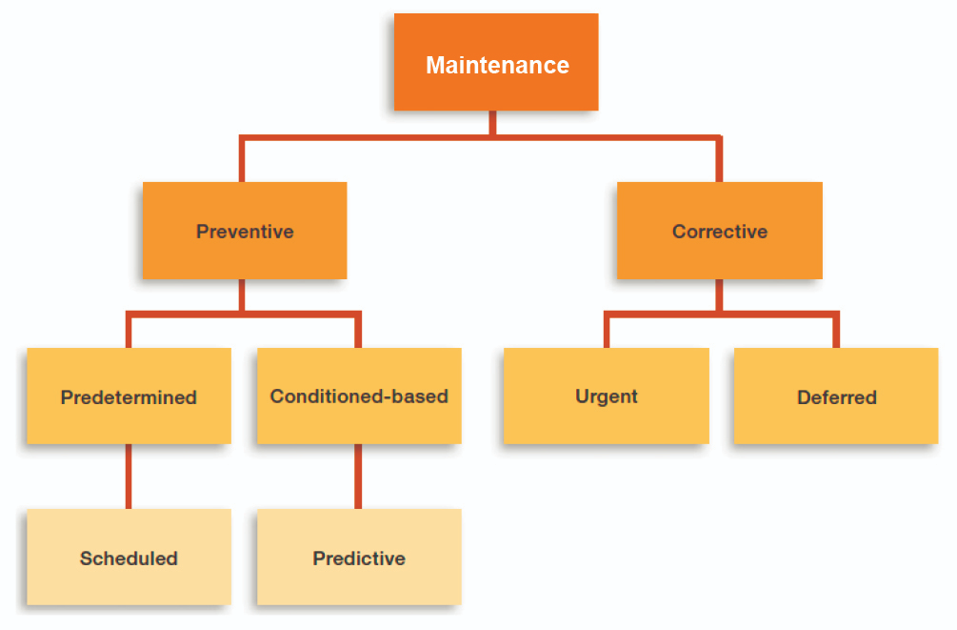
Evolution of maintenance Strategies
Individual Knowledge
Maint. Logs of Sys./Eqpt.
Experience Feedback
Trade-based Skill-sets
Procedures (OEM Guidelines)
Fault Detection & Diagnostics

Slide 3


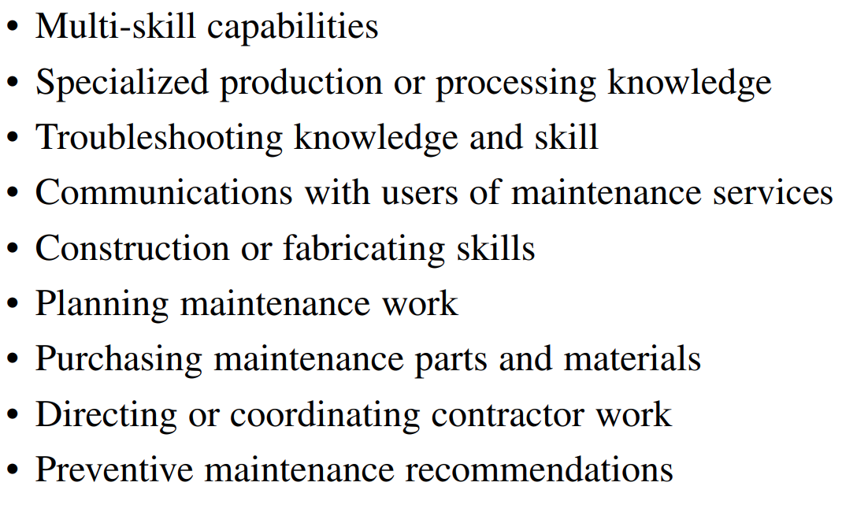
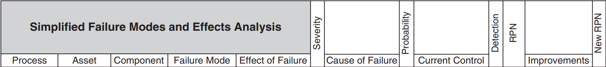
Functional Responsibilities in Maintenance Management
Pre-detection of incipient failures
Post-failure remedial-action decisions
Repetitive-job standardization
Computerized Maintenance Management Systems
Inventory Control
Supply Chain Management
RPN = Severity x Occurrence x Detection

Slide 4
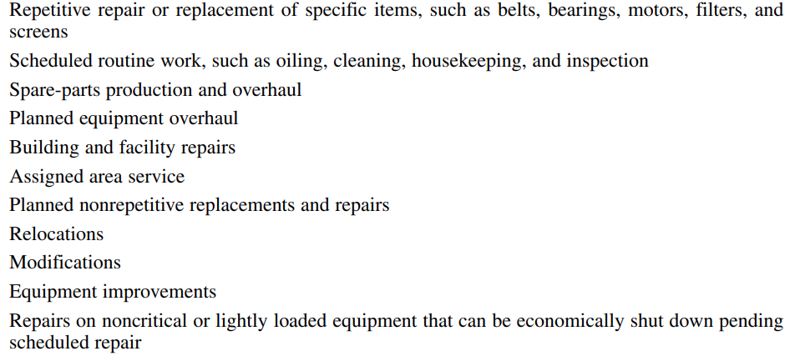
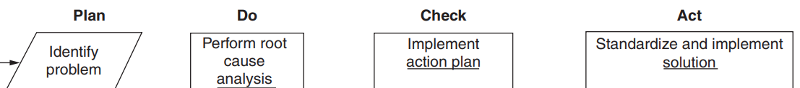
Maintenance Personnel Toolbox
Computerized Maintenance Management Systems

Slide 5
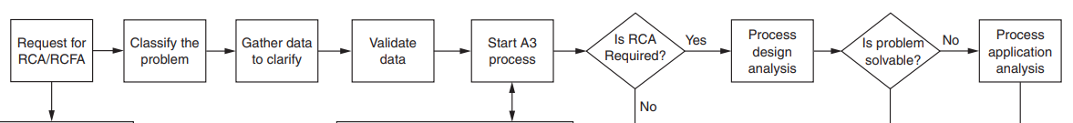
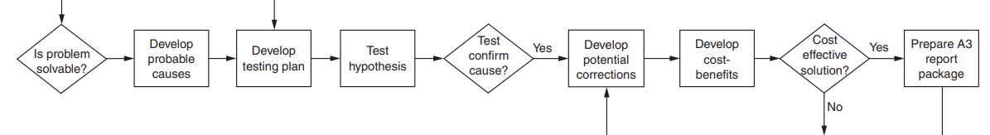
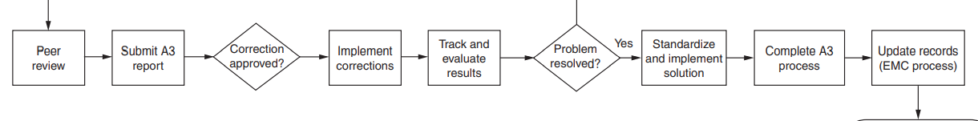
Root Cause Analysis (RCA) --- Concepts
System/Equipment Failure
Computerized Maintenance Management Systems
Automated RCA ---- Data Oriented, Missing Data Handling, Fitting Hybrid Models

Slide 6
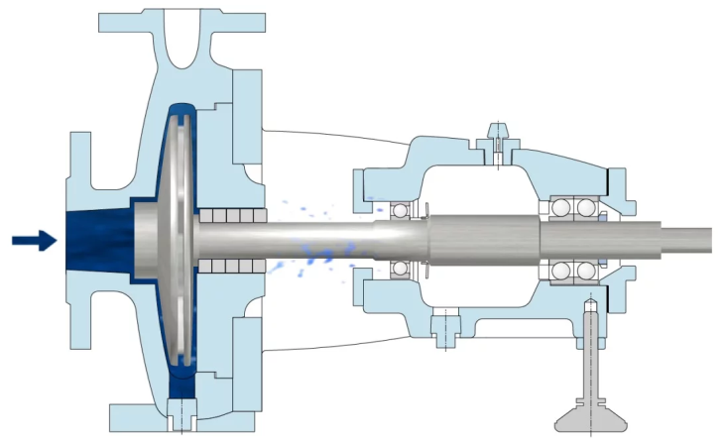
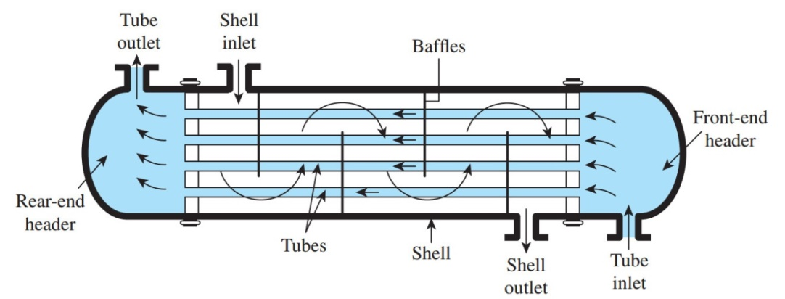
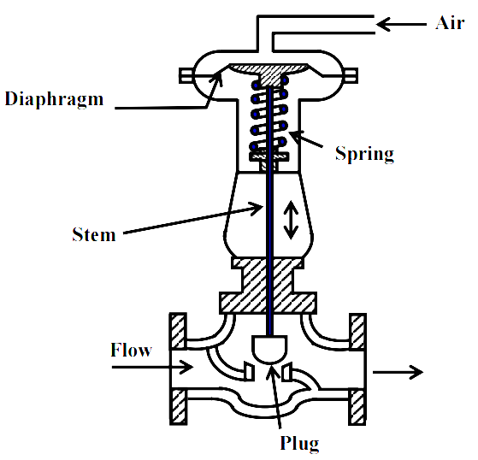
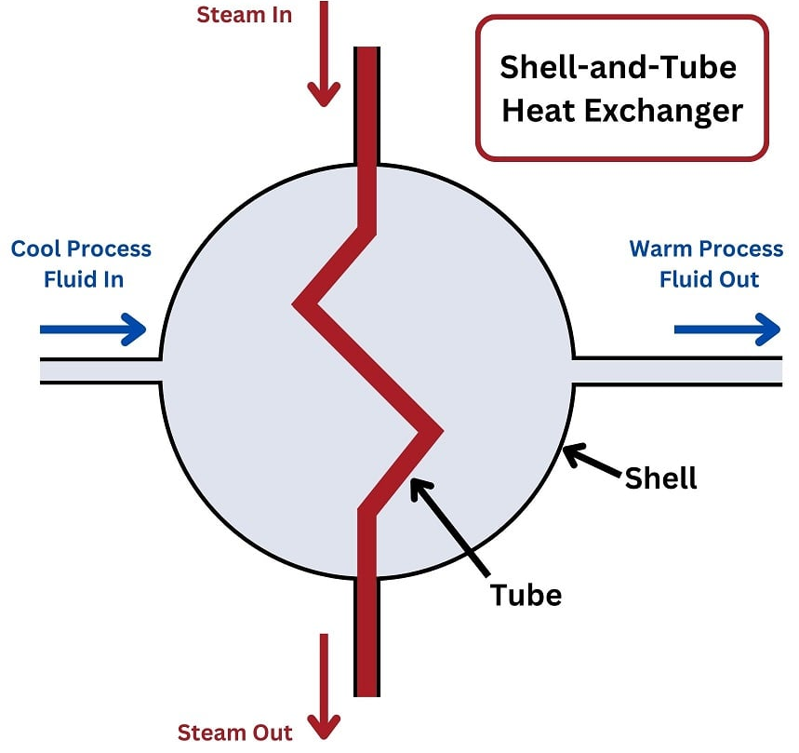
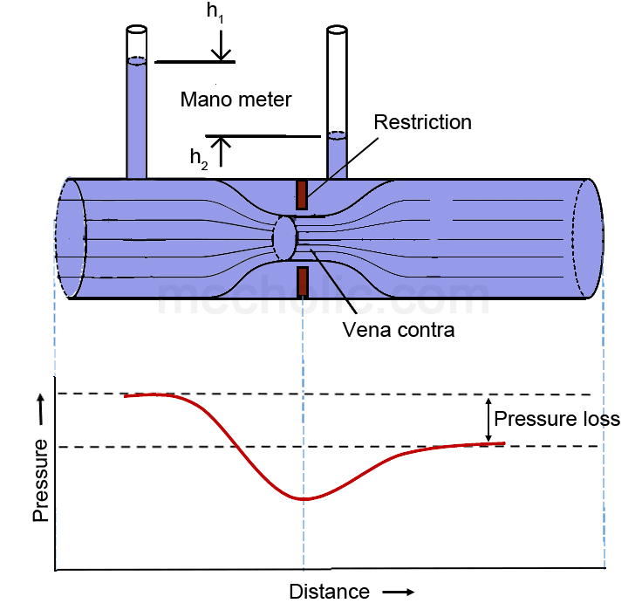
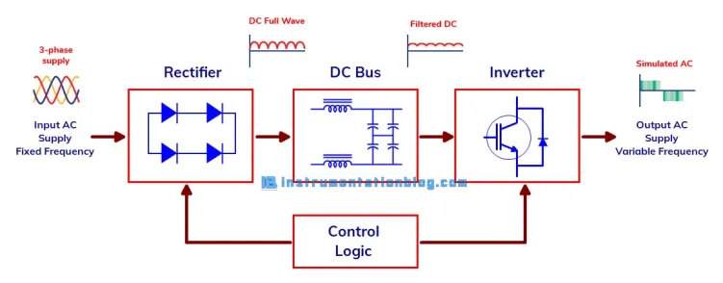
Making Simple Models – A Step towards Predictive Maintenance

Slide 7
Understanding Linear Systems
Second Order ODE, by hand

Slide 8
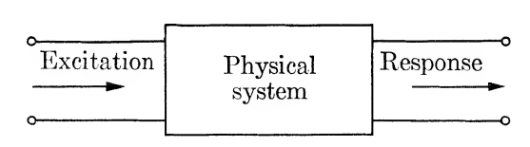
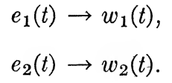
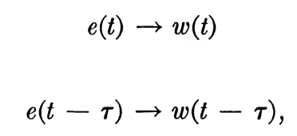
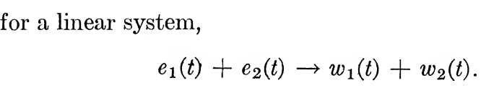

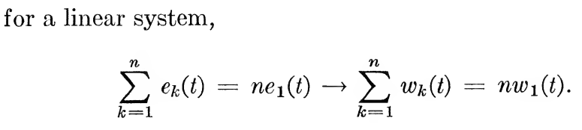
Understanding Linear Systems

Slide 9
Solution concepts of an ODE, by hand.

Slide 10

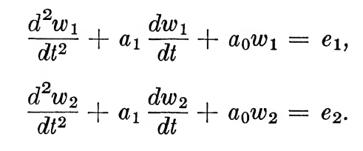
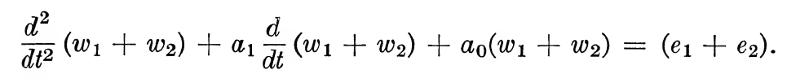
Conceptualizing Linear Models

Slide 11
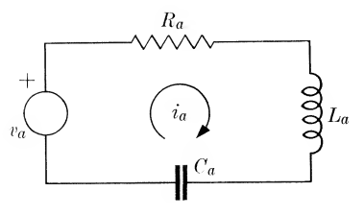

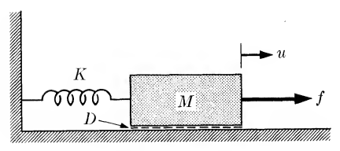


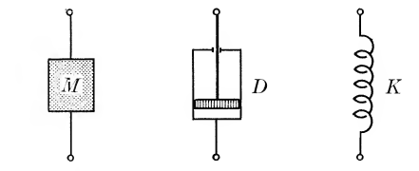

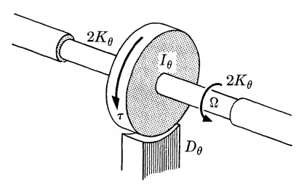


Analogous Systems

Slide 12
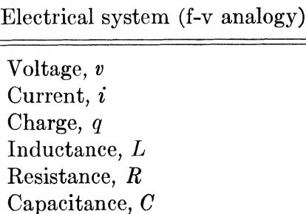
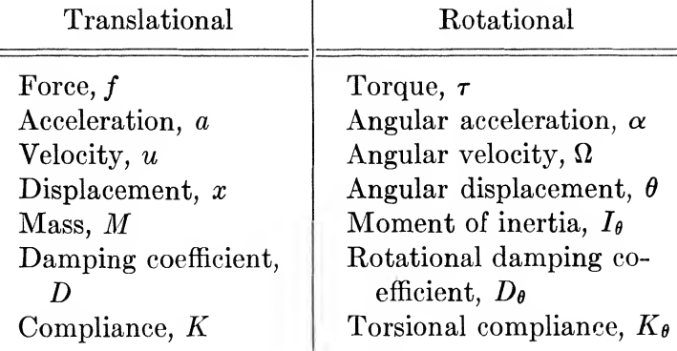

Slide 14
